Slide 1
Motivational Gifts Seminar

Slide 2
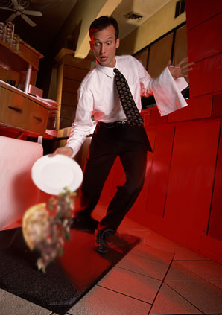

Slide 3

Types of Gifts
Motivational
Prophesy (Perceiver)
Teacher
Exhortation
Giving
Mercy (Compassion)
Service
Administration
Romans 12:6-8
Ministry
Apostle
Teacher
Prophet
Evangelist
Pastor
Ephesians 4:11
Apostles
Prophet
Teacher
Work Miracles
Healing
Helps/Service
Administration
Tongues
I Corinthians 12:28
Manifestation
Word of Wisdom
Word of Knowledge
Faith
Healings
Miracles
Prophecy
Discerning of Spirits
Various Tongues
Interpreting Tongues
I Corinthians 12:8-11

Slide 4
I Peter 4:10:11
Speaking Gifts:
Teacher
Exhorter
Administrator
Perceiver
Serving Gifts:
Server
Compassion
Giver
“Each one should use whatever gift he has received to serve others, faithfully administering God’s grace in its various forms. If anyone speaks, he should do it as one speaking the very words of God. If anyone serves, he should do it with the strength God provides, so that in all things God may be praised through Jesus Christ. To him be the glory and the power for ever and ever. Amen.”

Slide 5


A few more Scriptures
Let’s look at Proverbs 22:6 in the Amplified version. “Train up a child in the way he should go (and in keeping with his individual gift or bent) and when he is old he will not depart from it.” The Hebrew words had more meaning than most versions let us know about. We are each programmed differently. Any parent of 2 or more children can vouch for the differences seen at birth.

Slide 6

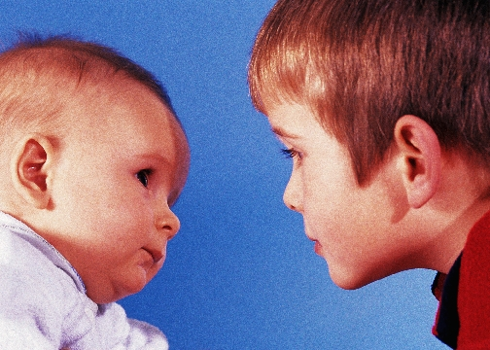
A few more Scriptures
Psalm 139:13-16
For You did form my inward parts; You did knit me together in my mother's womb. Your eyes saw my unformed substance, I will confess and praise You for You are fearful and wonderful and for the awful wonder of my birth! Wonderful are Your works, and that my inner self knows right well. My frame was not hidden from You when I was being formed in secret [and] intricately and curiously wrought [as if embroidered with various colors] in the depths of the earth [a region of darkness and mystery]. Your eyes saw my unformed substance, and in Your book all the days [of my life] were written before ever they took shape, when as yet there was none of them.

Slide 7
Each Gift Meets Specific
Human Needs
Gift
Perceiver (Prophet)
Server
Teacher
Exhorter
Giver
Administrator
Compassion (Mercy)
Definition
Declares the Will of God
Renders practical service
Researches and teaches the Bible
Encourages personal progress
Shares material assistance
Gives leadership and direction
Provides personal and emotional support.
Needs Met
Spiritual
Practical
Mental
Psychological
Material
Functional
Emotional
What it Does
Keeps us centered on spiritual principles
Keeps the work of ministry moving
Keeps us studying and learning
Keeps us applying spiritual truths.
Keeps specific needs provided for
Keeps us organized and increases our vision
Keeps us in right attitudes and relationships

Slide 8
Colored Glasses
Gift
Perceiver (Prophet)
Server
Teacher
Exhorter
Giver
Administrator
Compassion (Mercy)
What We See
Black or white/Right or wrong
What can I do to help?
Investigating and researching
Tries to see opportunities to encourage
Wants to invest his/her time, talent and money for others
Broad visionary
Loves to love

Slide 9
Now let’s take the Gifts Assessment

